Slide 1
Advantages of Mechanochemical Synthesis
Mechanochemical synthesis offers several benefits over conventional thermal or solution-based methods:
Solvent-free (or minimal solvent): Reduces waste, eliminates need for toxic or expensive solvents, aligns with green chemistry principles
Low temperature processing: Many reactions occur at room temperature or with minimal heating, saving energy
Short reaction times: Minutes to hours instead of days
Control over particle size and morphology: Direct influence through milling conditions
Access to metastable phases: High-energy polymorphs, amorphous materials, or non-equilibrium compositions
Scalability: Equipment ranges from laboratory mills to industrial-scale processors
Homogeneous mixing: Intimate contact at the atomic scale between reactants
These advantages make mechanochemistry attractive for materials synthesis, particularly for complex oxides, ceramics, and composites.

Slide 2
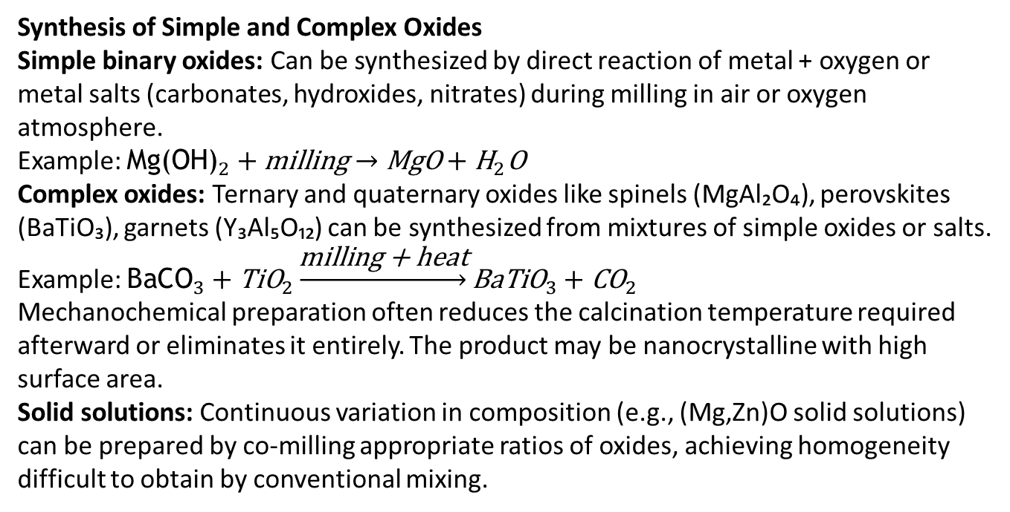
Synthesis of Simple and Complex Oxides
Simple binary oxides: Can be synthesized by direct reaction of metal + oxygen or metal salts (carbonates, hydroxides, nitrates) during milling in air or oxygen atmosphere.
Example: ${\text{Mg}\text{(}\text{OH}\text{)}}_{2}+\text{milling}→\text{MgO}+{\text{H}}_{2}\text{O}$
Complex oxides: Ternary and quaternary oxides like spinels (MgAl₂O₄), perovskites (BaTiO₃), garnets (Y₃Al₅O₁₂) can be synthesized from mixtures of simple oxides or salts.
Example: ${\text{BaCO}}_{3}+{\text{TiO}}_{2}\underset{→}{\text{milling}\text{ + }\text{heat}}{\text{BaTiO}}_{3}+{\text{CO}}_{2}$
Mechanochemical preparation often reduces the calcination temperature required afterward or eliminates it entirely. The product may be nanocrystalline with high surface area.
Solid solutions: Continuous variation in composition (e.g., (Mg,Zn)O solid solutions) can be prepared by co-milling appropriate ratios of oxides, achieving homogeneity difficult to obtain by conventional mixing.

Slide 3
Ceramic Materials Synthesis
Ferrites (MFe₂O₄): Magnetic ceramics synthesized from metal oxides or hydroxides. Mechanochemical route produces fine, reactive powders suitable for sintering into dense ceramics.
Example: NiFe₂O₄ from NiO + Fe₂O₃ by ball milling
Titanates and zirconates: Dielectric and piezoelectric materials. BaTiO₃, PbZrO₃, and PZT (lead zirconate titanate) can be mechanochemically synthesized with controlled stoichiometry.
Aluminates and silicates: Refractories, catalysts, and luminescent hosts. Mechanochemistry enables room-temperature formation of phases that normally require >1000°C.
Advantages for ceramics:
Reduced sintering temperature
Fine grain size improves mechanical properties
Homogeneous dopant distribution for functional ceramics (luminescence, conductivity)

Slide 4
Composite Materials
Mechanochemical synthesis is excellent for creating composite materials with intimately mixed phases:
Metal-ceramic composites: Dispersion of ceramic particles (oxides, carbides, nitrides) in a metal matrix. Mechanical alloying achieves nanoscale distribution.
Example: Al-Al₂O₃ composites (dispersion-strengthened aluminum)
Multiphase ceramic composites: Combining different ceramics for tailored properties (hardness, toughness, thermal stability).
Example: ZrO₂-Al₂O₃ composites
Core-shell structures: Sequential milling or controlled oxidation can create particles with a core of one material and a shell of another.
Nanocomposites: Mechanochemistry produces nanostructured composites with grain sizes <100 nm, leading to enhanced mechanical, electrical, or catalytic properties.
Applications: cutting tools, wear-resistant coatings, catalysts, energy storage materials.

Slide 5
Planning a Mechanochemical Synthesis
Step 1: Choose starting materials
Reactivity: more reactive precursors (hydroxides, carbonates, nitrates) vs. stable oxides
Purity and particle size of starting materials affect reaction kinetics
Cost and availability
Step 2: Select milling conditions
Type of mill (planetary, vibratory, attritor)
Ball-to-powder ratio (typically 5:1 to 20:1)
Milling speed and time
Atmosphere (air, inert, reactive gas)
Temperature control (cooling for sensitive materials)
Step 3: Monitor reaction progress
Periodically sample and analyze by XRD, FTIR, or other techniques
Look for disappearance of reactant peaks and appearance of product peaks
Step 4: Post-treatment (if needed)
Annealing to crystallize or densify
Washing to remove soluble impurities
Sieving or classification to control particle size distribution
Step 5: Characterize the product
Phase identification (XRD)
Morphology (SEM/TEM)
Particle size (BET, laser diffraction)
Functional properties (magnetic, electrical, optical)
Design considerations: Balance between activation and over-milling, avoid contamination from milling media, optimize energy input for desired phase.

Slide 6
Examples from Literature
Case 1: LaFeO₃ perovskite Synthesized from La₂O₃ + Fe₂O₃ by high-energy ball milling for 10 hours, followed by annealing at 700°C. Pure phase obtained, grain size ~30 nm. Used as catalyst for methane oxidation.
Case 2: ZnFe₂O₄ spinel Prepared from ZnO + Fe₂O₃ via mechanochemical activation (30 min) + calcination (600°C, 2h). Compared to conventional method (1000°C, 12h), energy and time savings were significant.
Case 3: MgAl₂O₄ spinel Direct synthesis from MgO + Al₂O₃ by planetary milling. Nearly single-phase product after 40 hours of milling without any heating. Nanocrystalline with potential for transparent ceramics.
Case 4: YAG (Y₃Al₅O₁₂) Mechanochemical synthesis from Y₂O₃ + Al₂O₃ with subsequent heat treatment produced phase-pure garnet. Doping with rare earths (Eu, Tb) during milling creates luminescent materials.
These examples demonstrate versatility, efficiency, and the ability to tailor material properties through mechanochemical routes.

